Slide 1
Power BI Project
Avocado Sales Analysis

Slide 2
Data Explanation
The data has:
40 970 Rows.
13 Columns:
Date, Average Price, Total Volume,
Product Lookup Code (PLU4046, PLU4225, PLU4770),
Total Bags, Small Bags, Large Bags, XLarge Bags,
Type, Year, Region

Slide 3
Goal
The main goal was to understand the data and answer the business
requirements using the time intelligence function.

Slide 4
Business Questions to Answer
What is the year over year growth in avocado sale?
How does the average price of avocados change from one year to another one?
Are there specific months where the avocados prices tend to be higher?
How does the sales volume vary by month?

Slide 5
Business Questions to Answer
To answer the business requirements, the time intelligence function is been used.
As Time intelligence function, we have:
SamePeriodLastYear,
DateSYTD,
DateMTD.

Slide 6
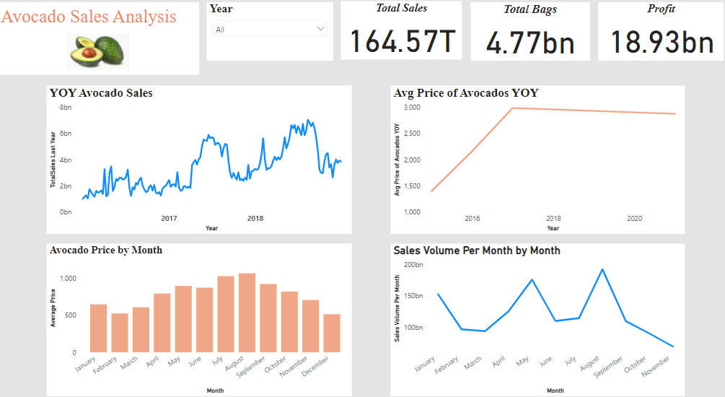
Dashboard

Slide 7
Findings
Overall,
The total sales is $164.57T, 4.77Bn of avocados bags have been sold and we have 18.93Bn of profit.
The demand of avocados is getting high year over year, this can be seen with an increase of the sales over the
year. Between 2015 to 2016, the sale has increased 7% and between 2016 to 2017 we have a 16% increased of units sold.
The average price of avocados has gradually increased from 2015 to 2017 and slightly dropped from 2017 to 2021 (3%).
The price of the avocados varies from one month to another. August is the month that has the higher price of avocado ($1.06).
Throughout the year, we have a pic of sales of avocados in May ($175.7 T) and August ($192.4 T).

Slide 8
Thanks For reading
Don’t forget to comment and add more insights

